Slide 1
Java
Suraj

Slide 2
Introduction
Simple
Object oriented
Distributed
Multithreaded
Dynamic
Architecture neutral
Portable
High performance
Robust
Secure

Slide 3
Get started quickly:
Java designed by James Goslin and team in 1995 and was named OAK .
Versions are java 1.0,1.2,1.4,1.5,1.7,1.8.
Java programming language is a powerful object-oriented language, it's easy to learn, especially for programmers already familiar with C or C++.

Slide 4
Differences bw C and JAVA
C
JAVA
Prodcedural
Compiled
NO OOPS
top-down {sharp & smooth} approach
User Defined Memory Management
Pointers
NO Exception Handling
Object-Oriented
C and Interpreted language
OOPS language
bottom-up {on the rocks} approach.
Behind-the-scenes Memory Management
NO Pointers
Exception Handling

Slide 5
JAVA environment
JAVA compiler (compiled and Interperted)
Java Virtual Machine (software in your System
Java API(Collection of classes and Interfaces)
IDE(integrated development Environment) for eg:Eclipse(Kepler),Netbeans(1.3)

Slide 6
Syllabus for core JAVA
Application
Control Statements
Arrays and Strings
Class Concepts
Inheritance
Interface and package
Exception Handling
Streams
Thread
Networking
JDBC

Slide 7
Data Types
Byte(1) - 2^7 to2^7-1 -127 to 128
Short(2) 2^15 to 2^15-1 -32,628 to 32,627
Int -2^31 to 2^31-1 -62424234 to 6242423
Long(8) -2^62 to 2^62-1 arabs
Float(4) – Precisions
Double(8) – 4 to 8 precisions

Slide 8
Syllabus for Advanced JAVA
Applet
Collection
Swings
JDBC
HTML, JavaScript
Servlets
JSP(Introduction basics)

Slide 9
SDLC
Software development Life Cycle
1.Requirement
2.Analysis
3.Coding
4.Testing
5.Deployement

Slide 10
Four types of Architecture
1. Single Tier -> Foxpro (Single User)
2. Two Tier (or) Client/Server Technology-> VB and Oracle (Multi user)
3. Three Tier -> HTML, ASP, Oracle

Slide 11
First Hello world
class first {
public static void main(String args[]) {
System.out.println("My First Java Program");
}
}
java class name and the filename may be same
**explanation of psvm

Slide 12
primitive datatypes
Type Size Range
---- ----- ------
byte 1 byte(2^7) -128 to +127
short 2 bytes(2^15) -32,768 to +32,767
int 4 bytes(2^31) -2,147,483,648 to +2,147,483,647
long 8 bytes(2^73) 9223372036854775808 to
char 2 bytes (Universal Code)
float 4 bytes - 3.4e38 to + 3.4e38
double 8 bytes -1.7e308 to +1.7e308

Slide 13
Arrays
Its called arrays of arrays(Java)
for(i=0;i<3;i++){
for(j=0;j<3;j++){
int a[i][j]=new int[i][j];
}
}
a[0] =new int[3];
a[0][1]= new int[2];
a[0][2]=new Int[7];

Slide 14
Type casting
Implicit(widening) (compiler itself does it)
Int x=‘a’;
Sop(x)
Explicit(Narrowing )(Programmer has to do it)
Int i=90;
Short s=(Short)i

Slide 15
Variables(local and Global)
1. Instance variable
Instance variables are used to define attributes or the state of particular object.
2. Local variable
Local variables are used inside blocks as counters or in methods as temporary variables.
3. class variable
class variables are global to a class and to all the instances of the class

Slide 16
Operators
Arithmetic + - * / %
Relational >, <, >=, <=, ==, !=
Logical &&, ||, !
Increment and Decrement ++,--
Conditional ?:
Assignment =
Bitwise &, |, ^, <<, >>
Arithmetic Assignment +=, -=, *=, /=, %=

Slide 17
Conditional statements
if statements
switch case
while loop while(true) while(1)
do while
for for(;;)
break;

Slide 18
if
public class Test {
public static void main(String args[]){
int x = 10;
if( x < 20 ){
System.out.print("This is if statement");
}
}
}

Slide 19
If else
public class Test {
public static void main(String args[]){
int x = 30;
if( x < 20 ){
System.out.print("This is if statement"); }
else{
System.out.print("This is else statement");
}
} }

Slide 20
Nested if
public class Test {
public static void main(String args[]){
int x = 30;
int y = 10;
if( x == 30 ){ if( y == 10 ){
System.out.print("X = 30 and Y = 10");
}
}
} }

Slide 21
Switch
public class Test {
public static void main(String args[]){
//char grade = args[0].charAt(0);
char grade = 'C';
switch(grade) {
case 'A' : System.out.println("Excellent!"); break;
case 'B' : System.out.println("Excellent!"); break;
case 'C' : System.out.println("Well done"); break; case 'D' : System.out.println("You passed"); case 'F' : System.out.println("Better try again"); break; default : System.out.println("Invalid grade");
} System.out.println("Your grade is " + grade);
} }

Slide 22
While
class WhileDemo {
public static void main(String[] args){
int count = 1;
while (count < 11) {
System.out.println("Count is: " + count); count++; }
} }

Slide 23
Do while
class DoWhileDemo {
public static void main(String[] args){
int count = 1;
do {
System.out.println("Count is: " + count); count++; } while (count < 11); } }

Slide 24
functions in Java
function with parameters
function without parameters
functions with return type
function without return type
function with para and no return type
function without parameter and return type
function with para and without return type

Slide 25
Git Repo
what is main branch
what is cloning
git clone https:url link
git status
git fetch -all
git branch
git checkout other_branch
git status
git commit -m “my message”
git push

Slide 26
OOPS CONCEPTS
1. Classes and Objects
Class -> Collection of member variables and member functions.
2.Inheritance Reusability of the code
3. Polymorphism One in many forms (run time and compile time)
4.Data Abstraction showing the required process and hiding the internal implementation
5.Data Encapsulation
Encapsulating or binding the data

Slide 27
Class
class class_name
{
access_specifier datatype var_name;
access_specifier return_type function_name(arguments);
}

Slide 28
Access Specifier
private -> With in a class
public -> Class, Subclass and main function(thru object)
protected -> Class and Subclass
no modifier -> similar to public ( Differed in package concept).
Note: By default, the variables and functions are no modifier.

Slide 29
Defining a Class Object
Class Sample{
Int a ,b;
Void fun(){
Statement1;
}
Class Main{
public static void main(String args[]){
Sample s=new Sample();
System.out.println(“a value is ”s.a);
s.fun1();
}
}

Slide 30
Constructors
Class Sample{
Int a=23;
Sample(){
Statementa;}
Sample(int w, int q){ return a;
Statemnet 2; return a;}
Sample(char e, int v){
Statement 3; return a;
}
Class Main{
public static void main(String args[]){
Sample s=new Sample(); Sample s=new Sample(23,23); Sample s=new Sample(‘r’,34);}}}

Slide 31
Passing object as arguments
Class Sample{
Int a;
Sample(){
Statementa;}
Sample(int w, int q){
Statemnet 2;}
Sample(Sample s){
Statement 3;
}
Class Main{
public static void main(String args[]){
Sample s1=new Sample(); Sample s2=new Sample(23,23); Sample s3=new Sample(s3);}}}

Slide 32
Method VS Constructors
Class Sample{
Void fun(){
System.out.println(“hi”);
}
Class Main(){
Public static vois main(String args){
Sample s=new Sample();
s. fun();
s.fun(parameters);
}
Class Sample{
Int a;
Sample(){
Statementa;}
Sample(int w, int q){
Statemnet 2;}
Sample(Sample s){
Statement 3;
}
Class Main{
public static void main(String args[]){
Sample s1=new Sample(); Sample s2=new Sample(23,23);

Slide 33
Function overloading
Class Sample{
Int a;
Void function1(){
Statementa;}
Class Sample23{
Int a;
Void function1();
}
Class Main{
public static void main(String args[]){
Sample s=new Sample(); s.fuction1();
Sample23 s23=new Sample23();
S23.function1();
}}}}}

Slide 34
Encapsulation
Class Sample{
Private: int a=90;
Public: char s=‘90’;
}

Slide 35
Inheritance
Single
Multi-Level
Multi-ple
Hybrid

Slide 36
PolyMorphism
Class Sample{
Int a;
fun(){
Statementa;}
fun(int w, int q){
Statemnet 2;}
fun(Sample s){
Statement 3;
}
Class Main{
public static void main(String args[]){
Sample s1=new Sample();
s1.fun()
s1 .fun(90,90);

Slide 37
Constructor prg
Class Sample{
Int a;
Sample(){
Statementa;}
Sample(int w, int q){
Statemnet 2;}
Sample(char e, int v){
Statement 3;
}
Class Main{
public static void main(String args[]){
Sample s=new Sample(); Sample s=new Sample(23,23); Sample s=new Sample(‘r’,34);}}}

Slide 38
Method OverLoading
class Sample

Slide 39
Method OverRiding
Class Sample{

Slide 40
This keyword
Class Sample{
Int a,b,c;
String s;
Sample(int a;){
this.a=a;}
Sample(String s1){
this.s=s1;}}
Class Main{
public static void main(String args[]){
Sample s1=new Sample(); Sample s2=new Sample(23,23); Sample s3=new Sample(“sijo”);}}}

Slide 41
Super Keyword
Class Parent {
int a;
Void Parent (){
System.out.printf(“hi I am constructor of parent ”)}
Class Sub {
int a;
Void Sub (){
Super();
System.out.printf(“hi I am constructor of Sub ”)}
Class Main{
public static void main(String …args){
Sub s=new Sub();
Parent p=new Parent();
}}
}

Slide 42
Abstraction
Abstract class Sample{
Int a=90;
Int fun(){
System.out.println(“hi I am fun with body”);
}
Float fun2();
}

Slide 43
Interface
Interface class SampleInt{
Void fun1();
Int fun2();
Public Final int a;
}

Slide 44
String
String are the important type in language.
In Java String is a class with methods and interfaces.
String s=“string_name”;
String s=new String(“String_name”);
S.strlen().concat,chatAt,indexAt(),etc…

Slide 45
StringBuffer
Strings are Immutable and canno be changed.
StringBuffer s=new StringBuffer(“xyz”);
StringBuilder has thread safety.
One string object can only be synchronized.

Slide 46
File Handling
File f=new File(“abc.txt”)//wont create just checks
F=new CreateFile(“abc.txt”)// will cretate
F.mkdir()// make the file a directory
=new File(f,”abc.txt”);
Exist(); mkdir(),isFile();isDirectory();delete();length();

Slide 47
Wirter and Reader(characters)
FileWriter fw=new FileWriter();// for writing in a file .
Write(),write(char[]),write(String s),flush();,close();
FileReader fr=new FileReader();(String name);
Read(),read(char c)

Slide 48
Buffered Writer and Reader
To write data in buffers
BufferedWriter br =new BuffereeWriter(write w);
(writer int , buffersize )
Write(), Write(char c), Write(String s), Write(),
Flush(),close();

Slide 49
BufferedReader
To Read data in buffers
BufferedReader br =new BuffereeReader(write w);
(writer int , buffersize )
read(), read(char c), readLine();Write(),
Flush(),close();

Slide 50
printWriter
Most enhanced version over all
By using before one we can only write char data but not primitive values (data types)

Slide 51
Methods
Write()
Write(char c[])
Write(String s)
Flush()
Close()
Print(int a;);
Print(char d);
Print(long l)
Print(double d )
Print(float f );

Slide 52
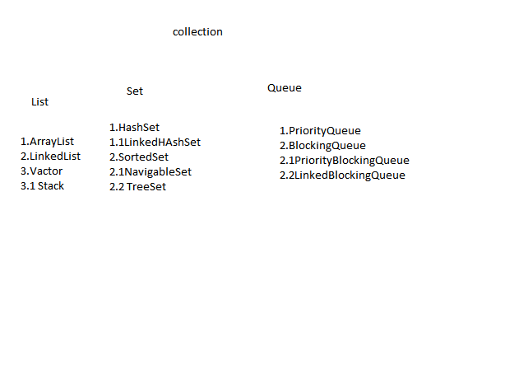
Collections

Slide 53
Code
Class {
PrintWriter p=new PW();
BufferedReader br=new BufferedReader();
String s=br.readline();
Write(s!=Null)
{
}
}

Slide 54
Advantages for collections
Array
collections
They are fixed in size
Memory part is not recomdeed to use
Performance not good
Homogenious data holding
No underlying DS
They are not
Recomemded
As expected
Heteroginious data
Ready DS for use

Slide 55
LIST(1.2v) and Array List(1.2)
If want to represent a group where insertion is prreserved and dupilcates are alllowed
ArrayList al=new ArrayList(),(collection c),(initn capacity),
METHODS a.add(),a.remove()

Slide 56
LinkedList(1.2)
LinkedList l=new LinkedList(),(collection c),
Void addFirst(),addLast(),object removeFirst(),removeLast(),getFirst(),getLast()

Slide 57
Vector(1.0)
Every method is Sync
Vector v=new Vector();
Add(object),add(index,object o),addElement(object), TO REMOVE remove(),removeElement(Object o),removeElementAT(int index);

Slide 58
Stack(1.0)
Stack s=new Stack();
Push();
Peek();
Search();
Empty();
Serach();

Slide 59
Set(1.2v)
If insertion order is not preserved ,duplicates are not allowed.
SortedSet()—according to some sorting order.
Navigable set-for navigation purpose

Slide 60
HashSet(1.2v)
DS- HashTable
Try to add dupicatate wont get CE but fails .
Heterogenious objetc allowed , null possible
HashSet hs=new HashSet();//16 initial capa
(init capacity),(init capacity, fill ratio);

Slide 61
LinkedHashSet(1.4)
Ds- Combination of HashTable and LinkedList.
Prmary memory to RAM and thn to Processor.

Slide 62
Sorted Set(1.2)
Object first(),last(),headSet()TailSet();subSet();
If want on some sorting order..

Slide 63
TreeSet(1.2)
DS- Balanced Tree
Insertion not preserved as its done on some tree sorting order.
TreeSet ts=new TressSet();
t.add(),t.add(new StringBuffer())//

Slide 64
PriorityQueue
BlockingQueue
PriorityBlockingQueue
LinkedBlockingQueue

Slide 65
Program
ArrayList al()=new Arraylist();
ArrayList al()=new Arraylist(int capacity);
ArrayList al()=new Arraylist(collection c);
a .add(),,,,a.remove();….new capacity =(old*3/2)+1;
LinkedList al =new LinkedList();
LinkedList al =new LinkedList(nt capacity);
LinkedList al =new LinkedList(collection c);
l.add()…l.set(position,”object”),,,, l.removeLast();,,,,l.addFirst();
Vector v=new Vector();
v.add(int index, object o)…v.addElement(object o),,,remove(object o),,,removeElement(object o),,,remove(int obj)
Stack s new Stack();
s.push()……s.pop()…

Slide 66
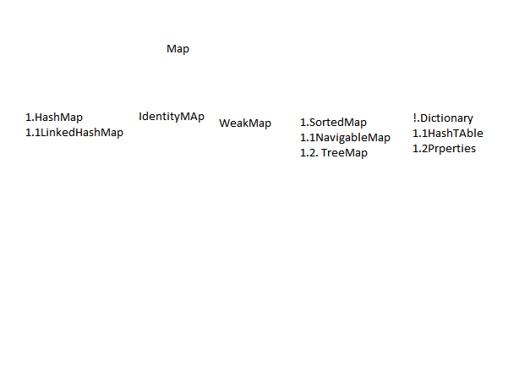
MAp

Slide 67
Exception and Error Handling
Runtime
Arthematic Exception
Null pointer Exception
ArrayIndexOutOfound Exception
ClassCast Exception
IlleggalArgument Exception
Number Format Exception
Illegal State Exception
IllegalThreadState Exception
IllegalMonitorState Exception
IndexOutOfBound Exception
InputOutPut Exception
FileNotFound Exception
EndOfFile Exception
InterruptedException Exception
Servlet Exception
Error
StackoverFlow
Outofmemory
Verufy Errror
IOExceptionn
Servelt Exception
InterruptedException
SqlException

Slide 68
Exception and Error Handling
Arthematic Exception
ArrayIndexOutOfound Exception
ClassCast Exception
IlleggalArgument Exception
Number Format Exception
Illegal State Exception
IllegalThreadState Exception
IllegalMonitorState Exception
IndexOutOfBound Exception
InputOutPut Exception
FileNotFound Exception
EndOfFile Exception
InterruptedException Exception
Servlet Exception

Slide 69
Try catch and Finally
Try{
Code which may generate exception
}
Catch(Exception e){
e.printStackTrace();
}
Finally{}

Slide 70
Throw
Sometime we can catch a exception and give JVM at the same time
{
45. throw new ArthematicException(“your msg”)
}

Slide 71
Throws
Class Sample throws IOExceptoin{
}

Slide 72
Threading
class Sample extends Thread{
public void run(){
for(int i=0;i<23;i++){
System.out.println(“hi”);
}
}
class Main(
public static void main(String args[]){
Sample s=new Sample();
s.start();
}}}}}

Slide 73
Threading Proirity
Sleep()
causes to sleep the thread for milliseconds
Join()
causes to wait the current thread and lets other same proirity thread to run
Wait()
waits until any thread notifies it
By dafault ---5,,, Maximum –10
High num have high proirity

Slide 74
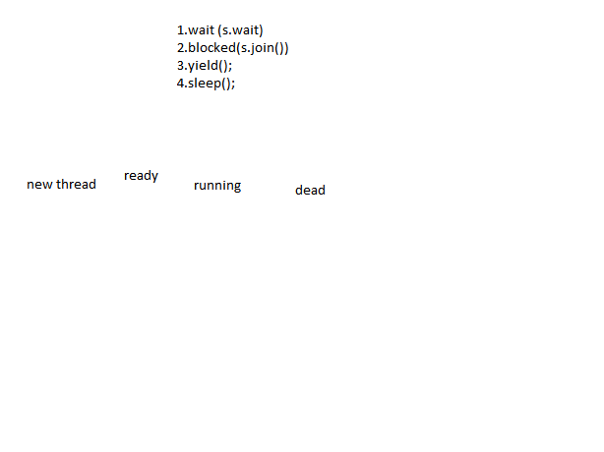
Thread Life Cycle

Slide 75
Exception Programs
class Sample[
Public static void main(){
try{
c=a+b;
System.out.println(“sijo”);
}
Catch(Exception e){
System.out.println(e);
}
finally{
Syste.out.println(“this will be execeuted anything may happen”);
}

Slide 76
Java Capabilities
Web Dynamic environment
Mobiltiy(Android ,BlackBerry,UI)
Cloud
Big Data
Network Security apps
Games
Animation Softwares

